Slide 2
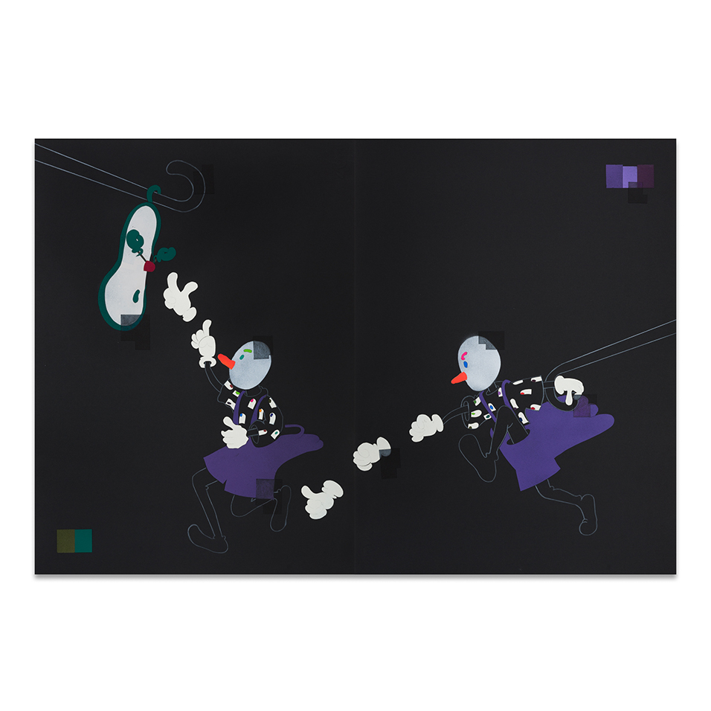
OONA GRIMES: Etruscan children #13, 2021
spray paint, collage & coloured pencil on paper, 76 x 112cm

Slide 3
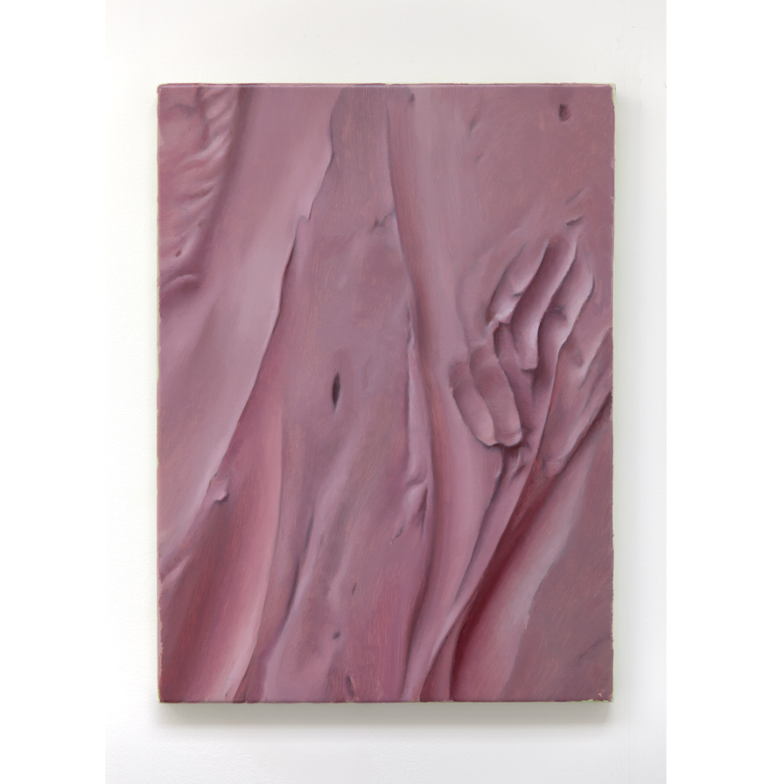
DAMIEN MEADE: Untitled, 2021
oil on canvas, 55 x 40.5cm

Slide 4
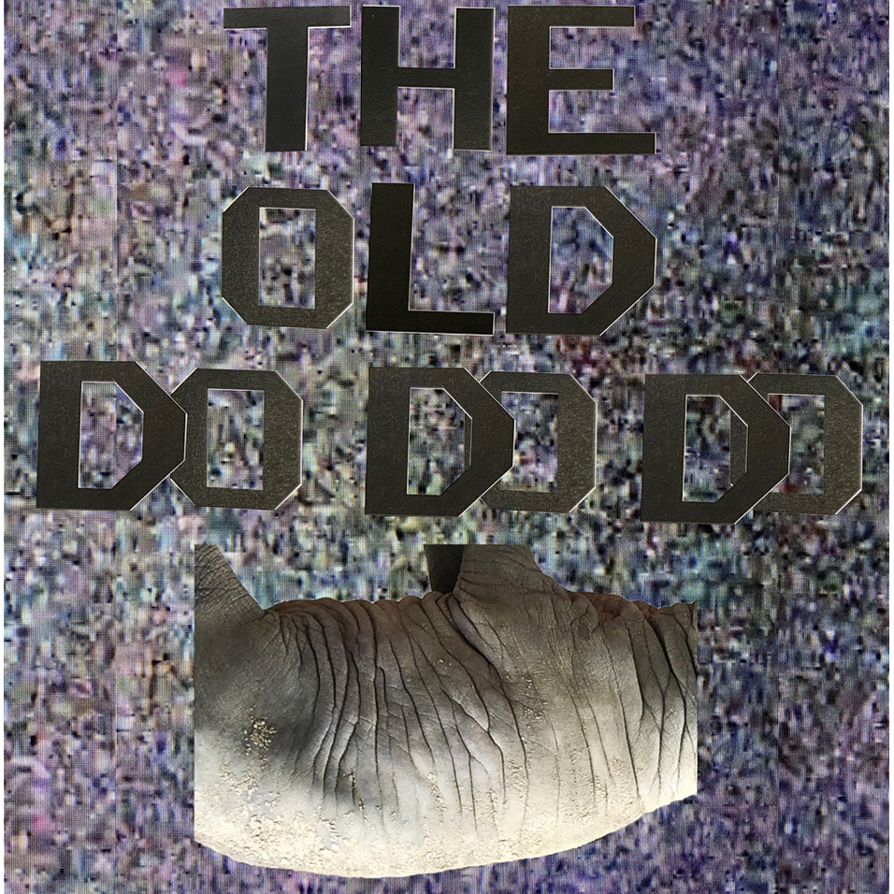
ANA GENOVES: The Old Do Do Do, 2021
digital image

Slide 5
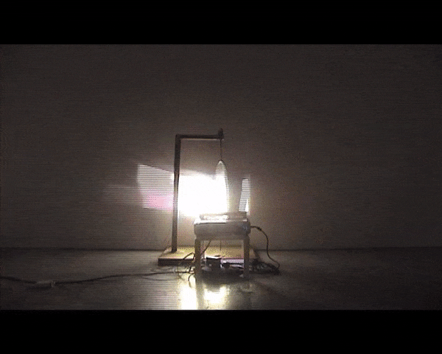
MARINA XENOFONTOS: Sequence 1, 2009
motor mechanism, mirror, wood, metal, projected image, dimensions variable

Slide 6
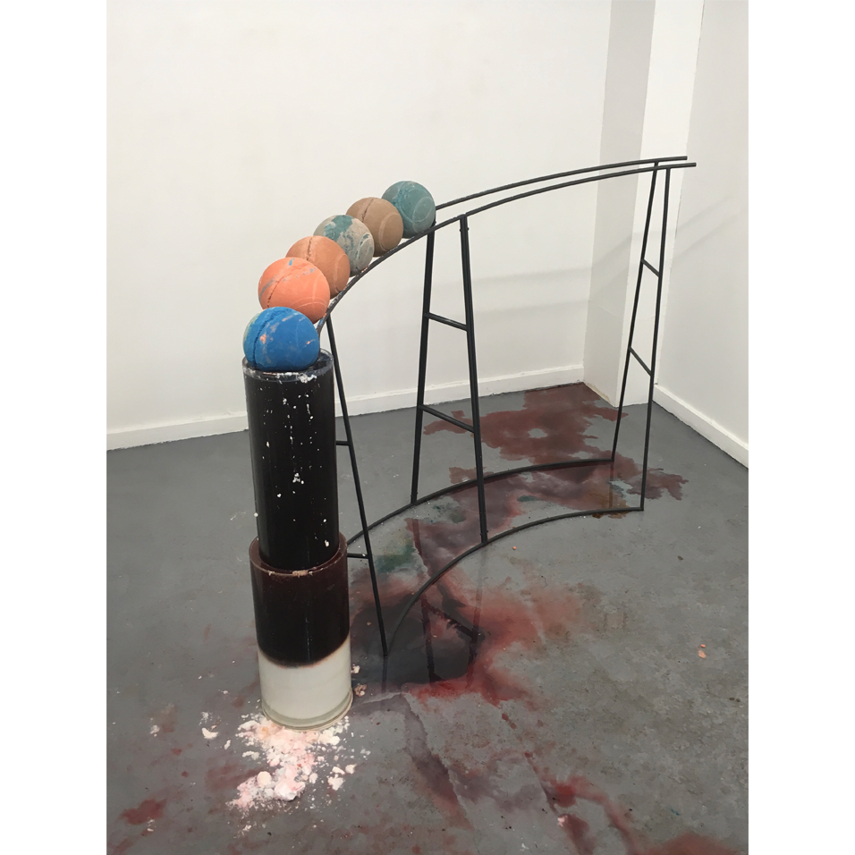
DANIEL PASTEINER: AntiWorldClock, 2019
acid, sodium, pigment, water, alkyd, glass, steel
189 x 390 x 170 cm

Slide 7
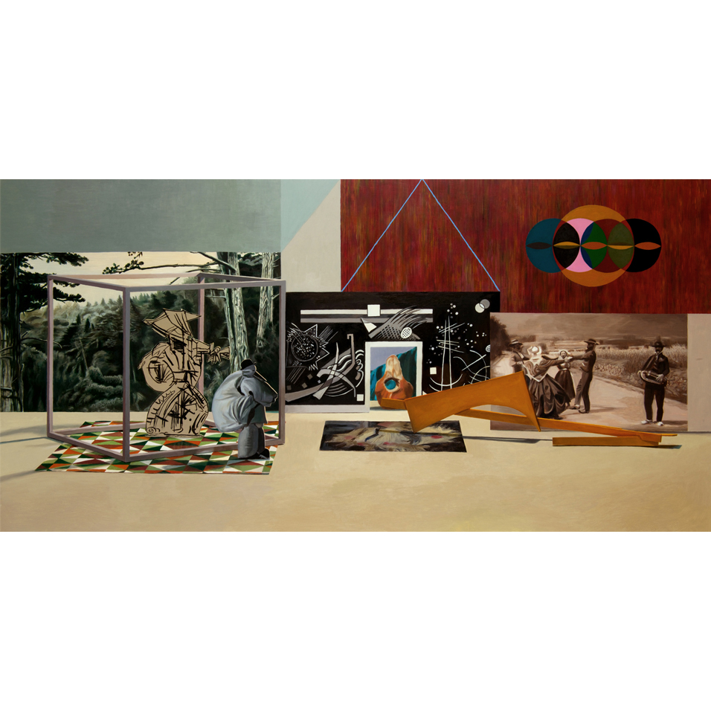
LOUISE BRISTOW: Creation Ritual, 2016
oil on MDF panel, 40 x 80cm

Slide 8
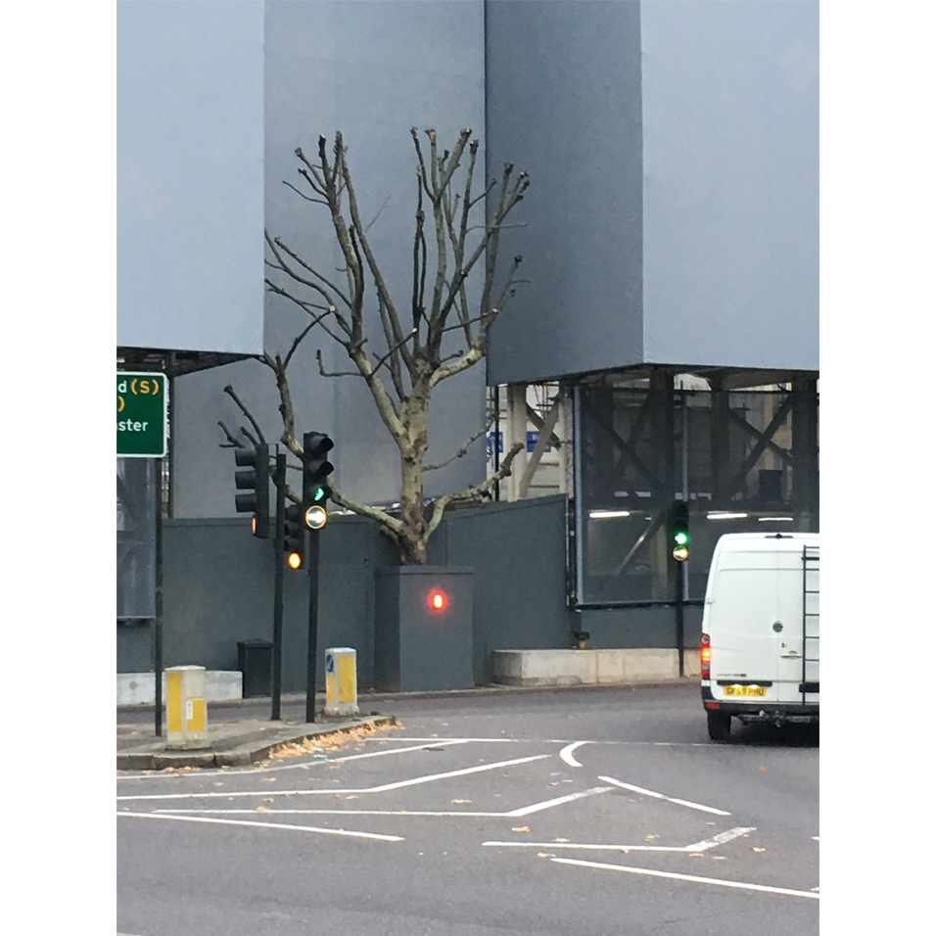
LUCY GUNNING: Tree Punishment
(detail from Leaves and Tangents), 2018
performance, dimensions variable

